Slide 1
Developing for Power BI with .NET 5
Ted Pattison
Principal Program Manager
Customer Advisory Team (CAT) at Microsoft

Slide 2
Agenda
Introduction to Power BI Embedding
Developing with .NET 5
Introducing Microsoft.Identity.Web
Calling the Power BI Service API
Programming the Power BI JavaScript API
Adding TypeScript Support to a .NET 5 Project
Programming with Multi-Resource Embed Tokens

Slide 3
Power BI Embedding – The Big Picture
User launches your app using a browser
App authenticates with Azure Active Directory and obtains access token
App uses access token to call to Power BI Service API
App retrieves data for embedded resource and passes it to browser.
Client-side code uses Power BI JavaScript API to create embedded resource
Embedded resource session created between browser and Power BI service
5
Power BI Service
Browser
iFrame
6
4
4
3
1
Your App
2
Azure AD

Slide 4
Choosing the Correct Embedding Model
User-Owns-Data Embedding
All users require a Power BI license
Useful in corporate environments
App authenticates as current user
Your code runs with user’s permissions
User’s access token passed to browser
App-Owns-Data Embedding
No users require Power BI license
Useful in commercial applications
App authenticates with app-only identity
Your code runs with admin permissions
Embed token passed to browser
User-Owns-Data Embedding for use within Organization
App-Owns-Data Embedding for use by ISVs
Browser
Power BI Service
Browser
Power BI Service
iFrame
iFrame
Azure AD
Access Token
Power BI
Embed Token

Slide 5
Agenda
Introduction to Power BI Embedding
Developing with .NET 5
Introducing Microsoft.Identity.Web
Calling the Power BI Service API
Programming the Power BI JavaScript API
Adding TypeScript Support to a .NET 5 Project
Programming with Multi-Resource Embed Tokens

Slide 6
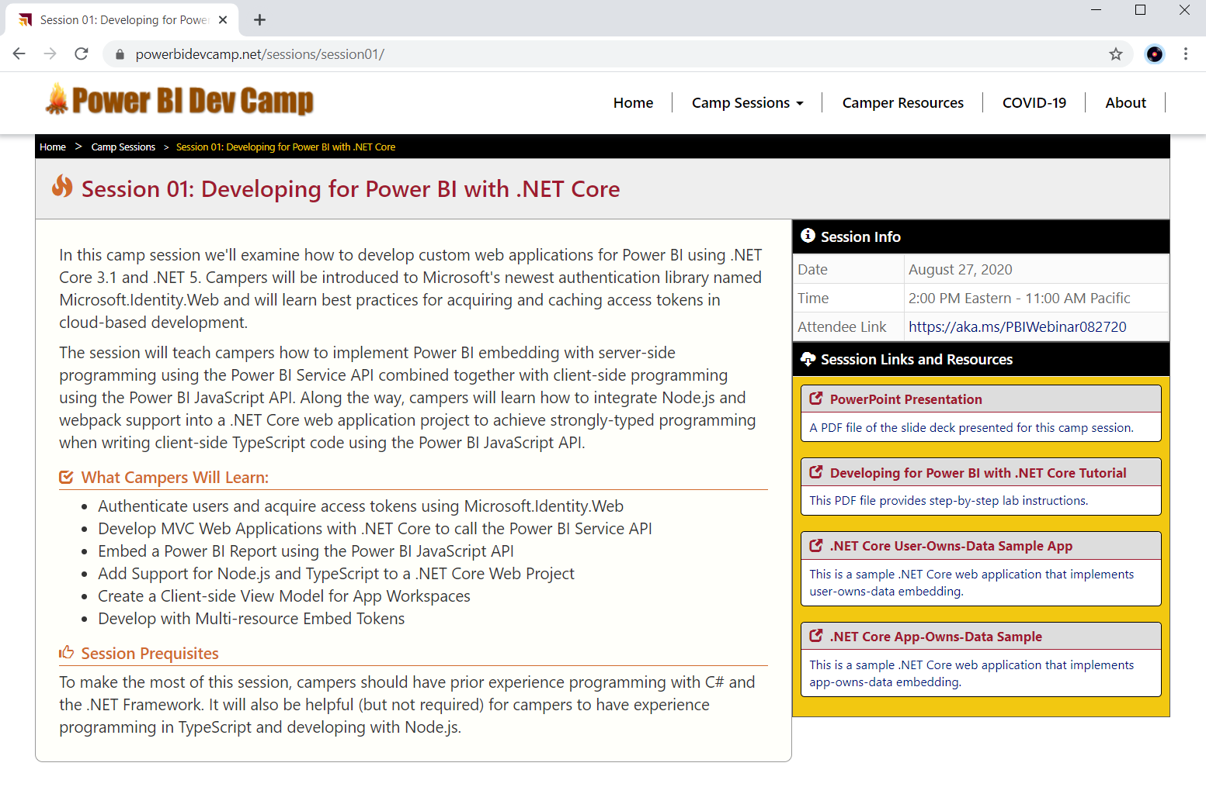
Welcome to Power BI Dev Camp
Power BI Dev Camp Portal - https://powerbidevcamp.net

Slide 7
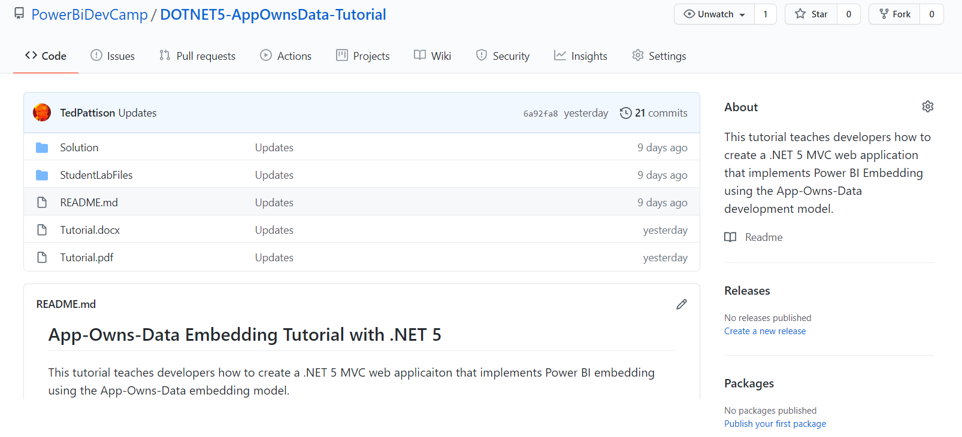
App-Owns-Data .NET 5 Tutorial
Stored in a GitHub repository for easy download
https://github.com/PowerBiDevCamp/DOTNET5-AppOwnsData-Tutorial

Slide 8
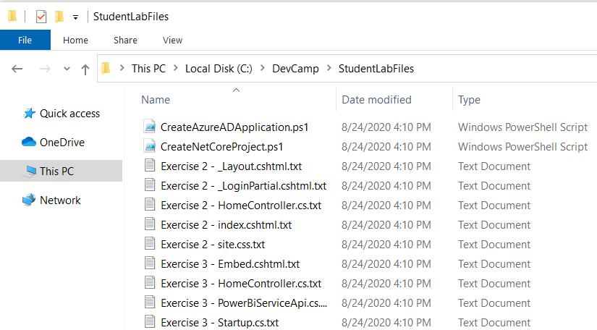
Copying-and-Pasting Code

Slide 9
Tutorial Exercise Flow
Exercise 1: Create a New Azure AD Application
Exercise 2: Create a .NET 5 Project for a Secure Web Application
Exercise 3: Call the Power BI Service API
Exercise 4: Embedding a Report using powerbi.js
Exercise 5: Adding TypeScript Support to a .NET 5 Project
Exercise 6: Creating a View Model for App Workspaces

Slide 10
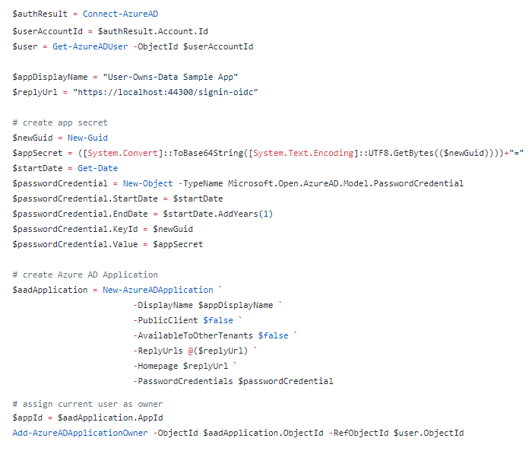
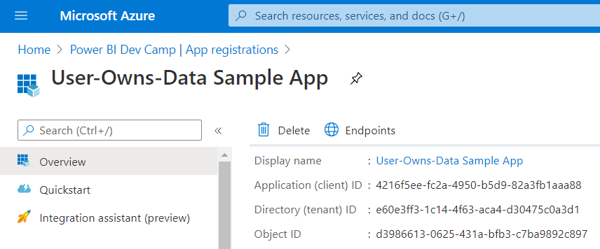
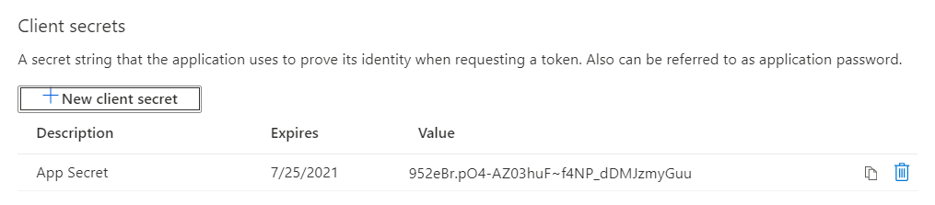
Creating Azure AD Application with PowerShell

Slide 11
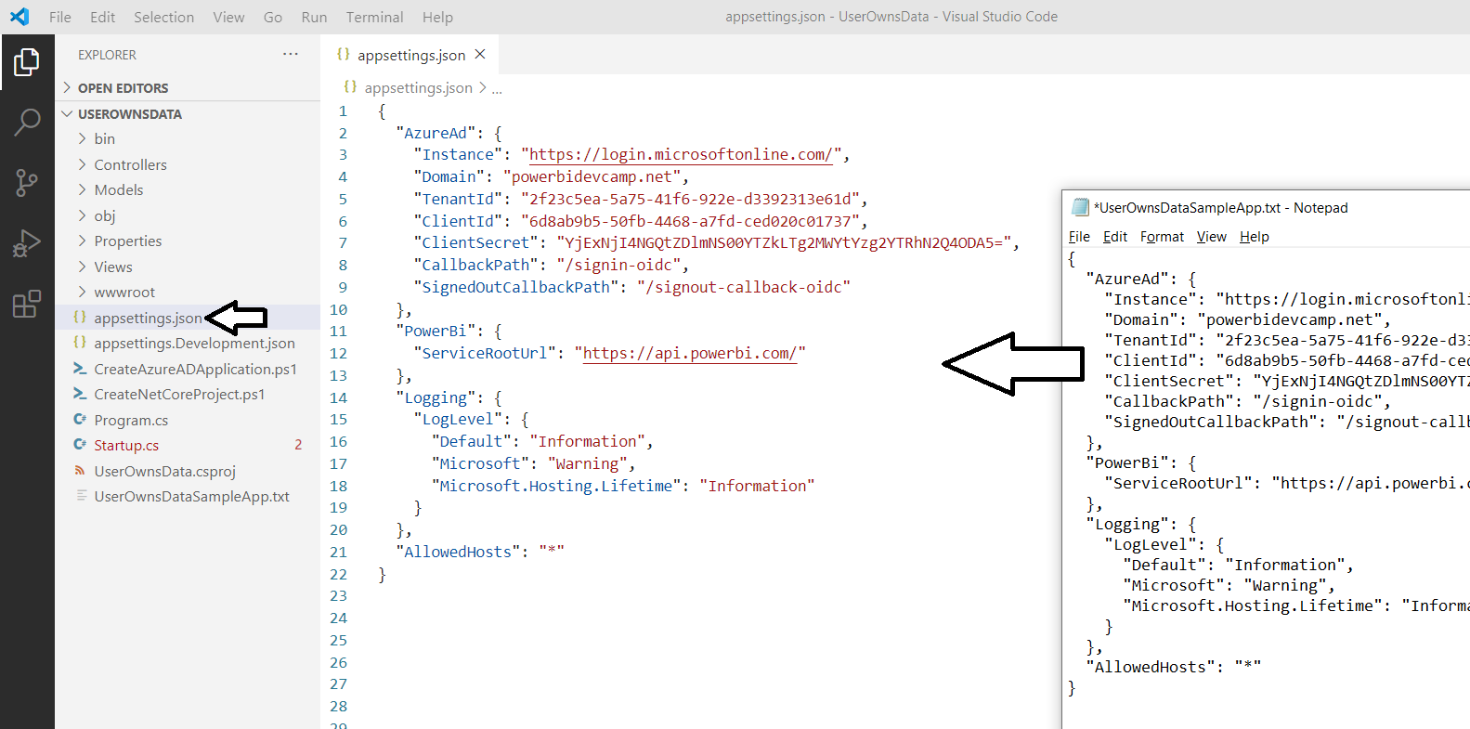
Azure AD Configuration in appsettings.json

Slide 12
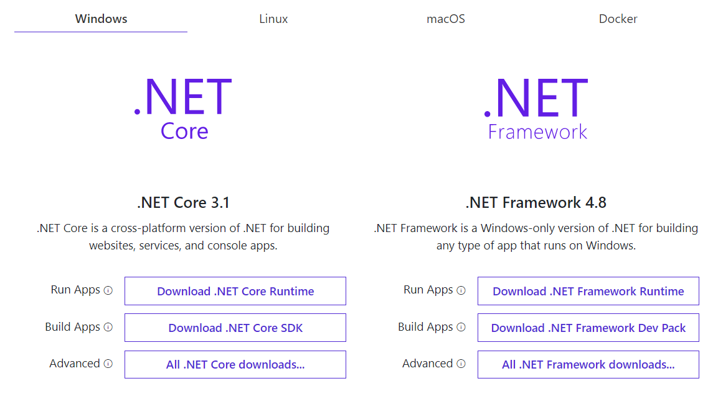
Install .NET 5 SDK
https://dotnet.microsoft.com/download

Slide 13
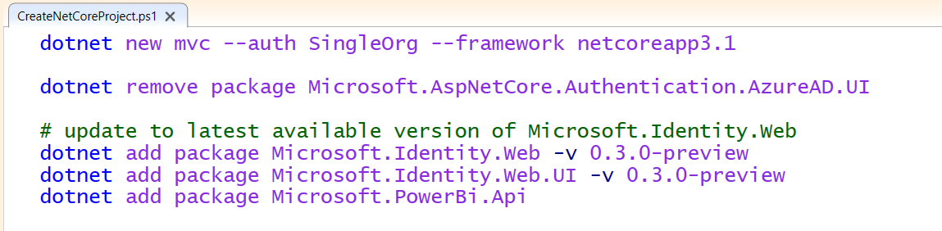
.NET 5 CLI
The .NET 5 command-line interface (CLI)
Cross-platform toolchain for creating, debugging and publishing applications
Create new applications using dotnet new command
Add NuGet packages using dotnet add package command

Slide 14
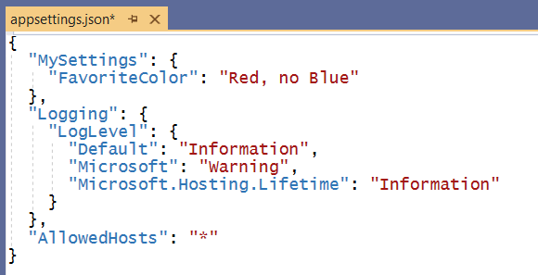
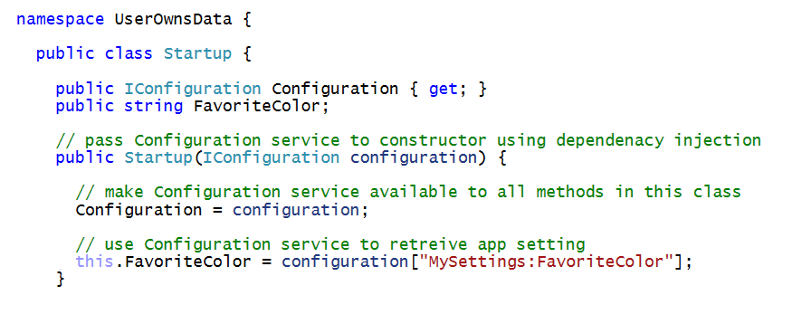
Understanding Dependency Injection is Essential
Services are registered on application start up
Services injected into classes using parameterized constructors
Dependency injection

Slide 15
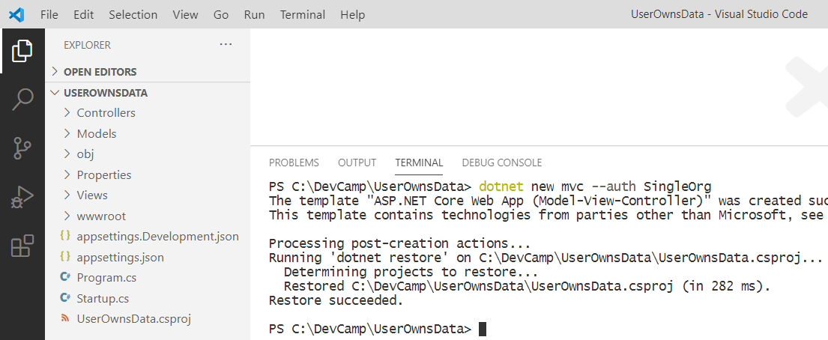
Create a New .NET 5 MVC Web Application Project

Slide 16
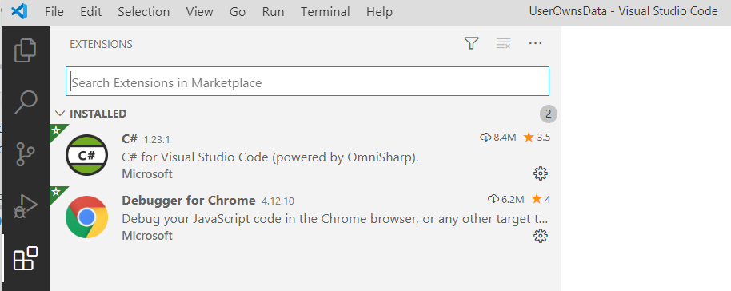
C# Extension for Visual Studio Code

Slide 17
Agenda
Introduction to Power BI Embedding
Developing with .NET 5
Introducing Microsoft.Identity.Web
Calling the Power BI Service API
Programming the Power BI JavaScript API
Adding TypeScript Support to a. NET Core Project
Programming with Multi-Resource Embed Tokens

Slide 18
Introducing Microsoft.Identity.Web
What is Microsoft.Identity.Web
Set of components and classes to assist developers
Used to perform authentication in Web applications and Web APIs
Used to acquire access tokens
Used to implement token caching
When to use Microsoft.Identity.Web
In Web application and Web APIs built on .NET 3.1 and .NET 5
Microsoft.Identity.Web is currently in preview
Released with .NET 5 in November 2020
More info at https://github.com/AzureAD/microsoft-identity-web/wiki

Slide 19
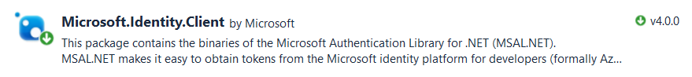
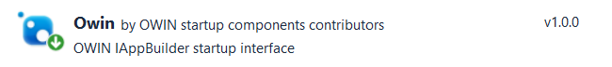
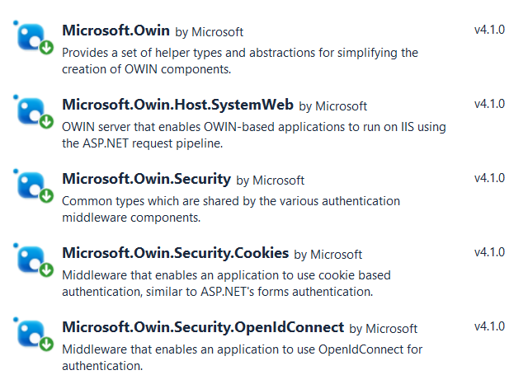
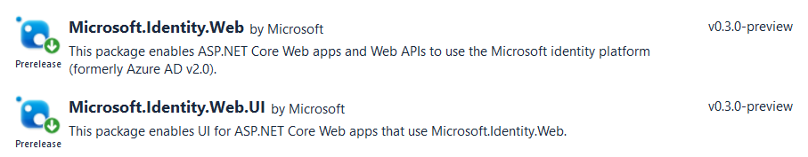
Microsoft Authentication Libraries
What did we do before Microsoft.Identity.Web?
Use Microsoft.Identity.Client (MSAL) to acquire and cache access tokens
Use OWIN Middleware components to implement OpenID connect
Microsoft.Identity.Web supports OpenID Connect and token acquisition

Slide 20
Implement User Login using Microsoft.Identity.Web
Create a Confidential Client Application in Azure AD
Implement OpenID Connect using Microsoft.Identity.Web
Test Secured Routes in an ASP.NET 5 Web Application

Slide 21
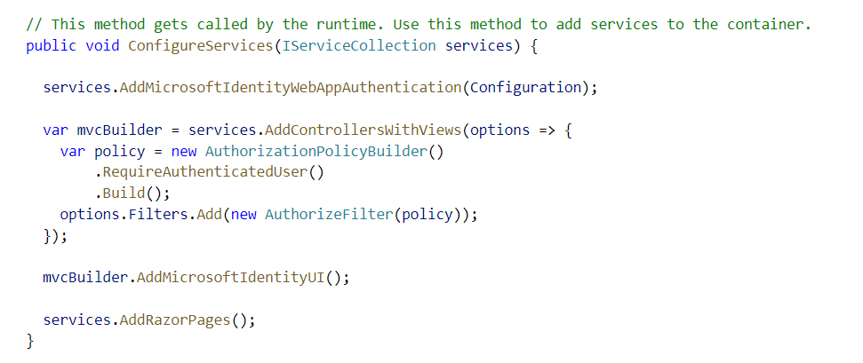
Enabling Authentication with Microsoft.Identity.Web

Slide 22
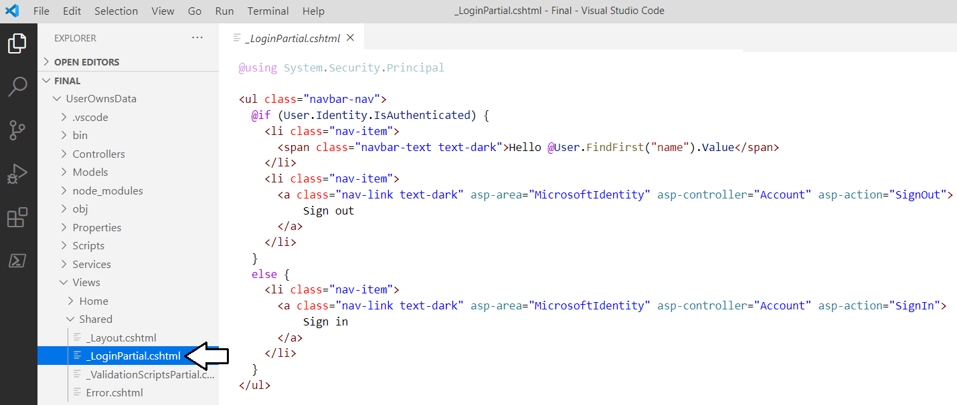
Adding Sign in / Sign Out Links

Slide 23
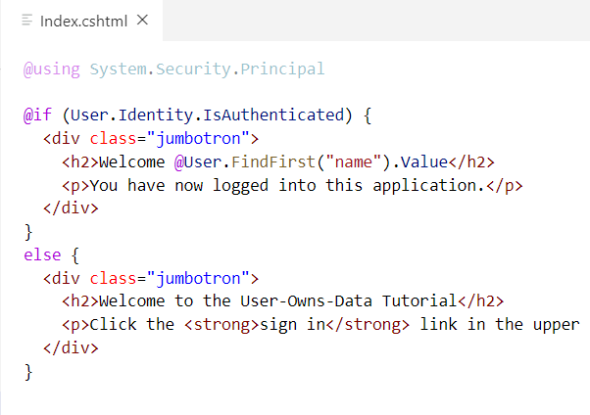
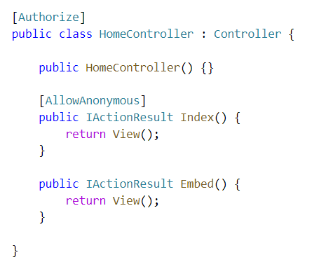
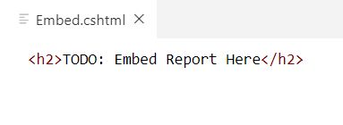
ASP.NET Supports Route Authorization
Routes with [AllowAnonymous] accessible to anonymous user
Routes secured with [Authorize] only accessible to authenticated users
Navigating to secured route automatically prompts for sign in
Index.cshtml
Embed.cshtml

Slide 24
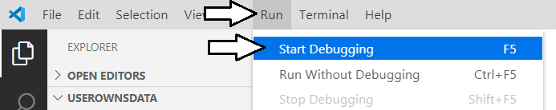
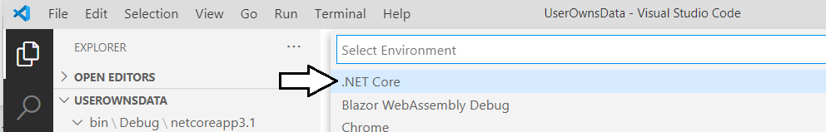
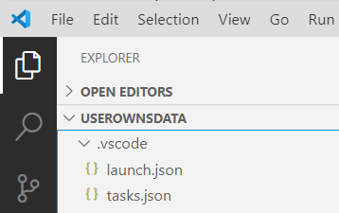
Starting a .NET 5 Debugging Session

Slide 25
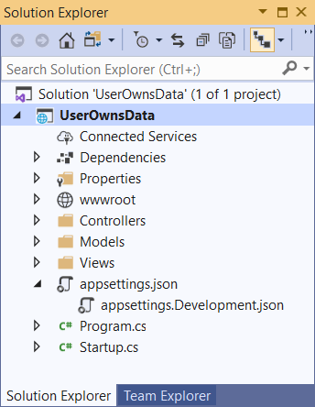
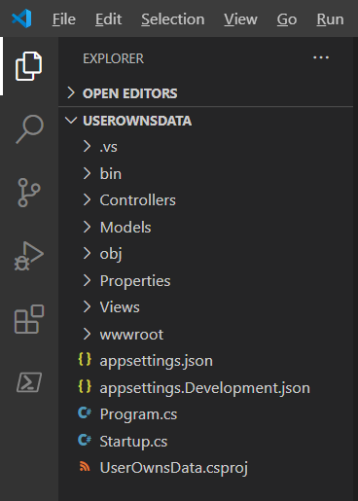
Visual Studio 2019 versus Visual Studio Code
Should you use Visual Studio 2019 versus Visual Studio Code?
Yes, either one can be used to develop for .NET 5 3.1 and .NET 5

Slide 26
Agenda
Introduction to Power BI Embedding
Developing with .NET 5
Introducing Microsoft.Identity.Web
Calling the Power BI Service API
Programming the Power BI JavaScript API
Adding TypeScript Support to a.NET 5 Project
Programming with Multi-Resource Embed Tokens

Slide 27
What Is the Power BI Service API?
What is the Power BI Service API?
API built on OAuth2, OpenID Connect, REST and ODATA
API secured by Azure Active Directory (AAD)
API to program with workspaces, datasets, reports & dashboards
API also often called “Power BI REST API”
What can you do with the Power BI Service API?
Publish PBIX project files
Update connection details and datasource credentials
Create workspaces and clone content across workspaces
Embed Power BI reports and dashboards tiles in web pages
Create streaming datasets in order to build real-time dashboards

Slide 28
App-only Access Control
Service Principal used to configure access control
Requires the use of v2 app workspaces
Service principal added to app workspaces as admin
Access control NOT based on Azure AD permissions
App Workspace 1
Admins
User 1
User 2
App 1 Service Principal
Power BI Service
App 1 Service Principal
App-only Access Token
App Workspace 2
Admins
User 1
App 1 Service Principal
App 2 Service Principal

Slide 29
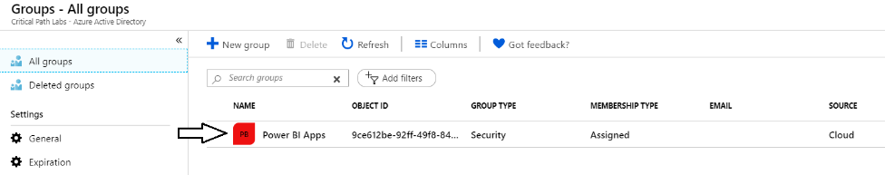
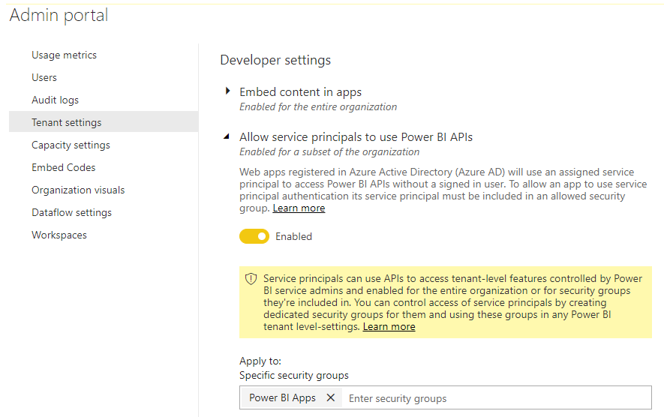
Setting Up for App-Owns-Data – Part 1
Enable Service Principal Access to Power BI Service API
Create an Azure AD security group (e.g. Power BI Apps)
Add group to Power BI Allow service principals to use Power BI APIs

Slide 30
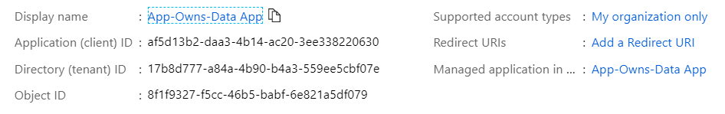
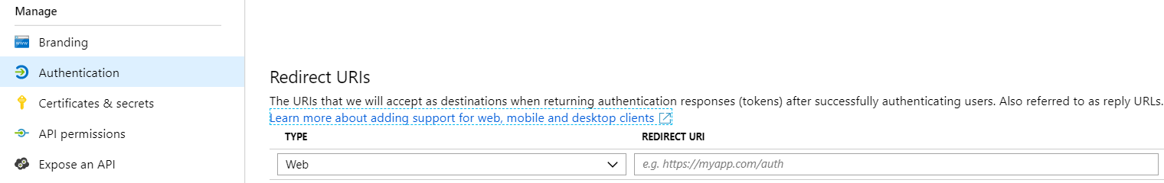
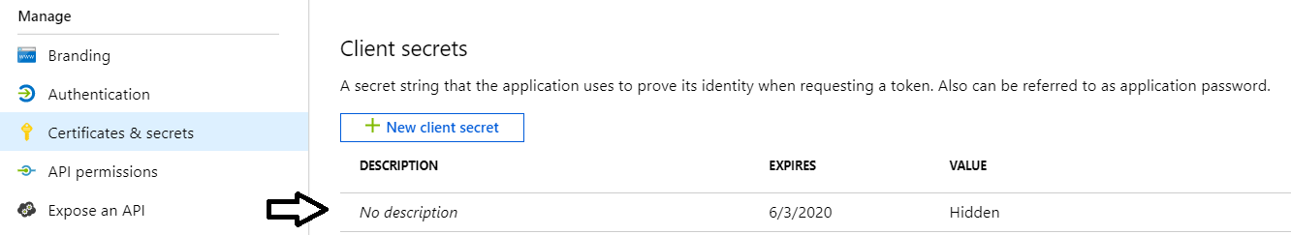
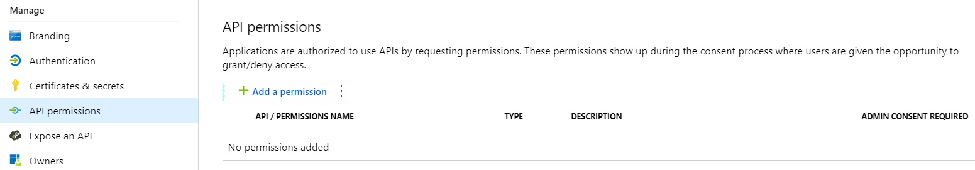
Setting Up for App-Owns-Data – Part 2
Create a confidential client in your Azure AD tenant
Configured as TYPE=Web and no need for a redirect URL
Add a client secret or a client certificate No need to configure any permissions

Slide 31
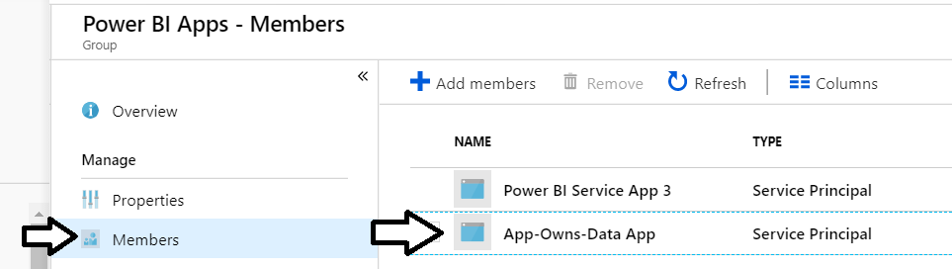
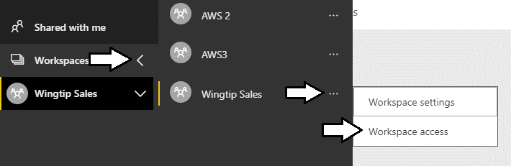
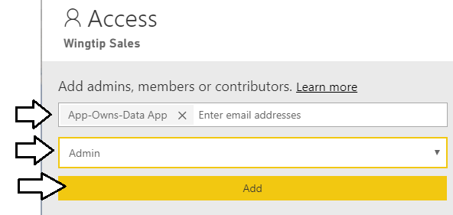
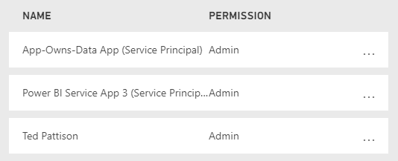
Setting Up for App-Owns-Data – Part 3
Add application's service principal in Power BI Apps security group
Configure application's service principal as workspace admin
Service principal should now be workspace admin

Slide 32
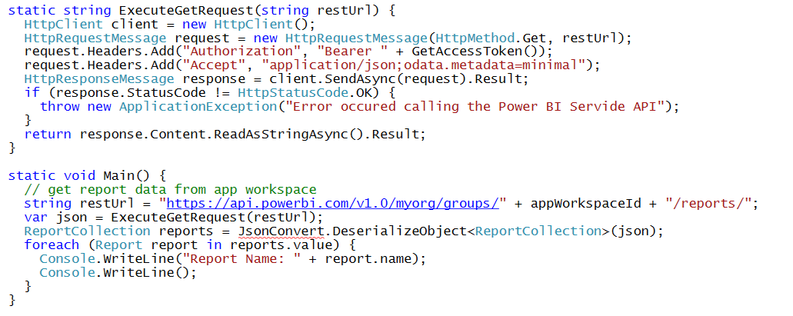
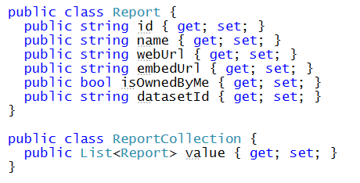
Calling the Power BI Service API Direct REST calls without using the Power BI .NET SDK
Your C# Code
Power BI
Service API
Executing HTTP Requests
Capturing HTTP Responses
Serializing/Deserializing JSON

Slide 33
Power BI .NET SDK
Developing without the Power BI .NET SDK
Developing with the Power BI .NET SDK
Your C# Code
Power BI
Service API
Executing HTTP Requests
Capturing HTTP Responses
Serializing/Deserializing JSON
Your C# Code
Power BI
Service API
Power BI .NET SDK
Executing HTTP Requests
Capturing HTTP Responses
Serializing/Deserializing JSON

Slide 34
Exercise 3 Call the Power BI Service API
Add a new class named PowerBiServiceApi
Add support to acquire access tokens using Microsoft.Identity.Web
Call Power BI Service API to get embedding data for a report
Pass the embedding data for a report to the browser

Slide 35
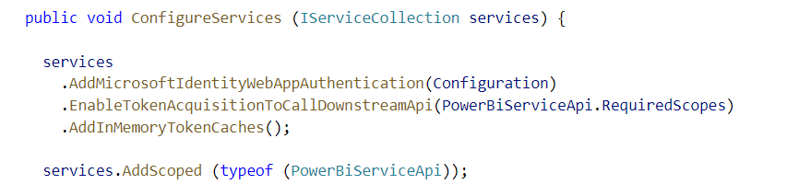
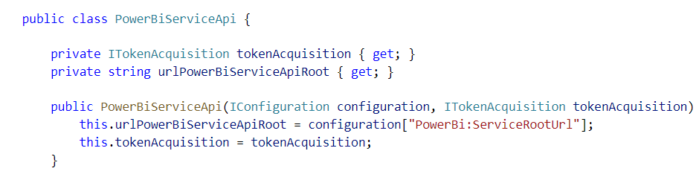
Adding Support for Token Acquisition
Modify ConfigureService in Startup.cs
Add a new C# Class named PowerBiServiceAPi
Dependency injection

Slide 36
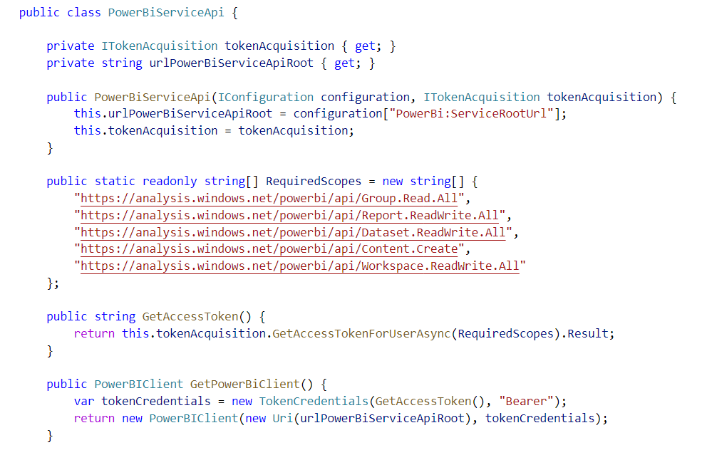
Adding Support for Acquiring Access Tokens

Slide 37
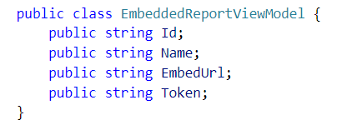
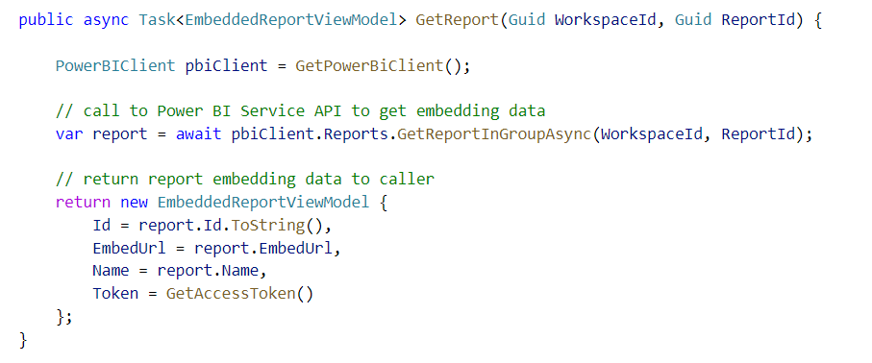
Call GetReportInGroupAsync to Get Embedding Data

Slide 38
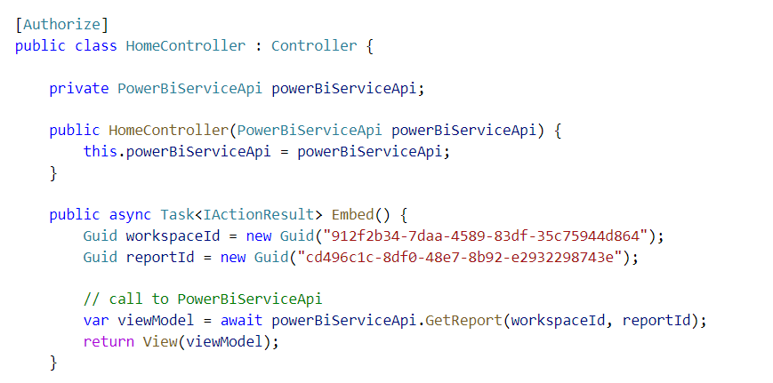
Accessing PowerBiServiceApi from a Controller
Dependency injection
MSAL Token Acquisition Service
PowerBiServiceAPI
HomeController
Dependency Injection
Dependency Injection

Slide 39
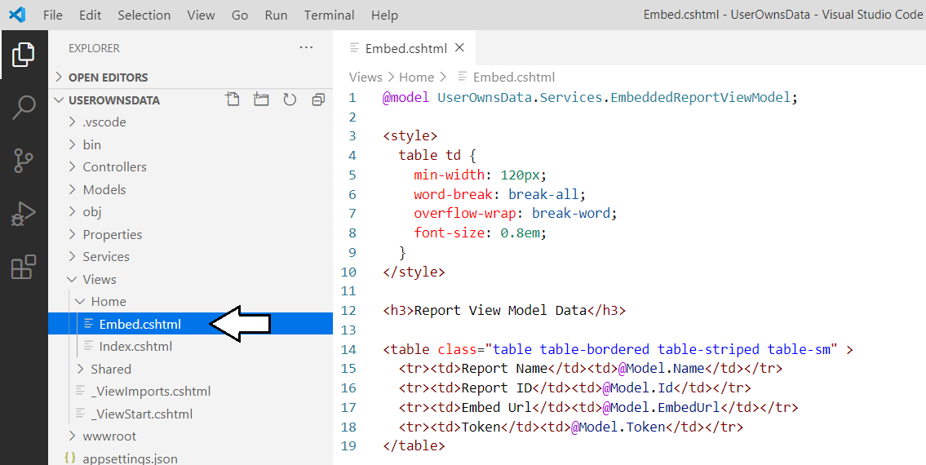
Displaying Data from the View Model

Slide 40
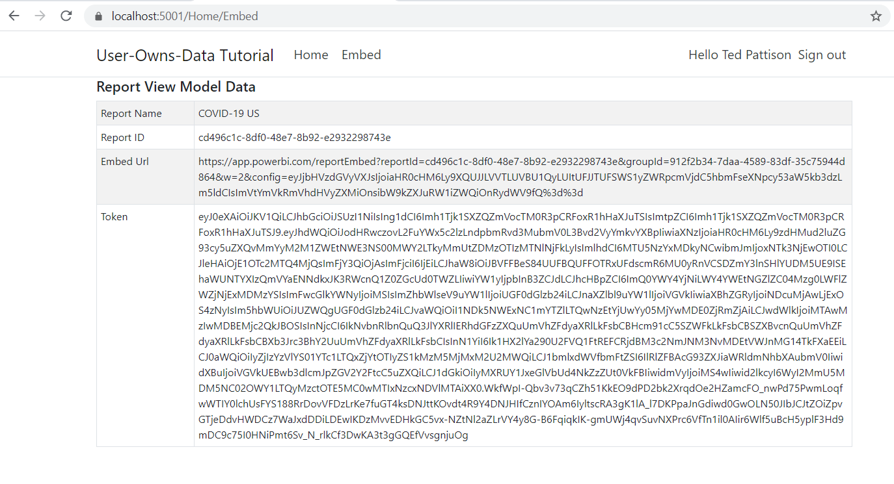
Exercise 3 Finale

Slide 41
Agenda
Introduction to Power BI Embedding
Developing with .NET 5
Introducing Microsoft.Identity.Web
Calling the Power BI Service API
Programming the Power BI JavaScript API
Adding TypeScript Support to a.NET 5 Project
Programming with Multi-Resource Embed Tokens

Slide 42
Exercise 4 Embedding a Report using powerbi.js
Add a script link to powerbi.js
Create view model to pass embedding data to browser
Write JavaScript code to embed a report

Slide 43
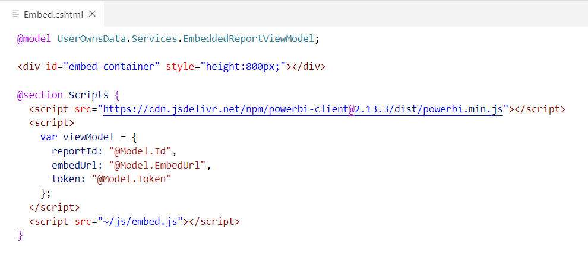
Creating a Simple View To Embed a Report
First script link loads Power BI JavaScript API
Second script link adds view model to web page with report embedding data
Third script link loads a custom Javascript file named embed.js that you will write

Slide 44
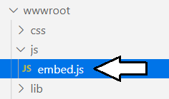
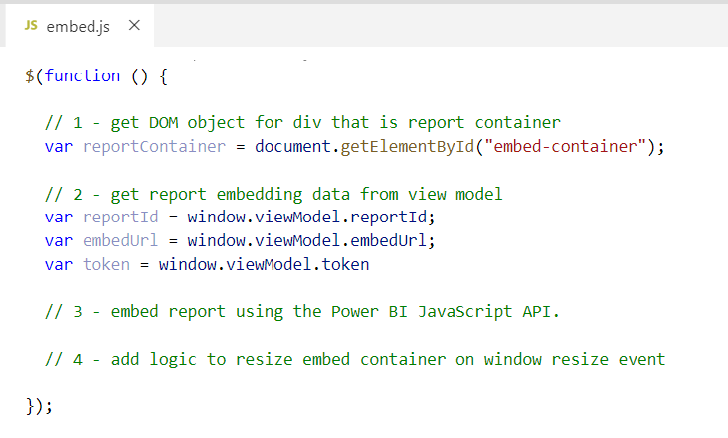
Retrieving Data from the Report View Model

Slide 45


Embedding a Report using powerbi.js

Slide 46


Dynamically Resizing the Embed Container

Slide 47
Agenda
Introduction to Power BI Embedding
Developing with .NET 5
Introducing Microsoft.Identity.Web
Calling the Power BI Service API
Programming the Power BI JavaScript API
Adding TypeScript Support to a.NET 5 Project
Programming with Multi-Resource Embed Tokens

Slide 48
Exercise 5 Adding TypeScript/Webpack Support to a .NET 5 Project
Copy package.json file to UserOwnsData project root folder
Execute npm install to install Node.js packages
Copy tsconfig.json and webpack.config.js to root folder
Add new TypeScript file named embed.ts
Execute npm run build to compile embed.ts to embed.js
Update UserOwnsData.csproj with npm run build command

Slide 49


Adding Node.js Support for TypeScript Compilation

Slide 50


Running npm install

Slide 51

Understanding Webpack and Dynamic Module Loading
embed.ts
webpack
embed.js
jquery.js
Typescript Compiler
Powerbi.js

Slide 52


Running npm build

Slide 53

Updating UserOwnsData.csproj

Slide 54


Running dotnet build

Slide 55

Programming the PBI JS API using TypeScript

Slide 56


Exercise 6 Creating a View Model for App Workspaces

Slide 57

Creating the User Experience

Slide 58
Agenda
Introduction to Power BI Embedding
Developing with .NET 5
Introducing Microsoft.Identity.Web
Calling the Power BI Service API
Programming the Power BI JavaScript API
Adding TypeScript Support to a.NET 5 Project
Programming with Multi-Resource Embed Tokens

Slide 59

Programming with Multi-Resource Embed Tokens
Used in App-Owns-Data embedding

Slide 60
Summary
Introduction to Power BI Embedding
Developing with .NET 5
Introducing Microsoft.Identity.Web
Calling the Power BI Service API
Programming the Power BI JavaScript API
Adding TypeScript Support to a.NET 5 Project
Programming with Multi-Resource Embed Tokens

Slide 61
Questions

